Slide 1
Venn secures work and protects your privacy
Notes:
Venn secures work and protects your privacy by isolating business activity from any personal use on the same computer.

Slide 2
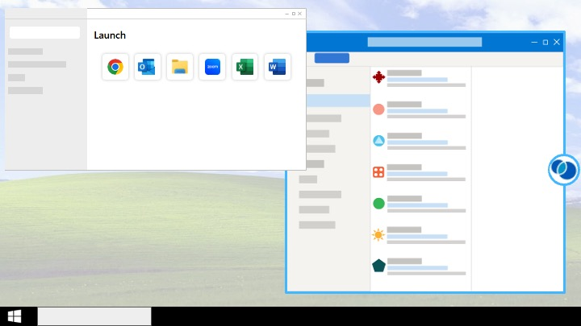
Notes:
In order to use Venn, you simply install Venn’s Blue Border software onto your computer and open your work applications and files from the Launcher (left).
Your work applications and files will open with a blue border around them (right), letting you know that they’re protected.

Slide 3




Why Venn?
Protects work data, files, and internet traffic
Intuitive and easy to use
Work happens on your computer, not a remote server
Protects your privacy
Notes:
Protects work data, files, and internet traffic
The Blue Border acts as a container that stores and protects all things work related
Work data and files are stored securely and work internet traffic is filtered and encrypted
Work happens on your computer, not a remote server
Many remote work solutions rely on a remote or virtual desktop setup, which can result in slowness or connection issues
Intuitive and easy to use
It really is as simple as you saw on the last slide; all you need to do is open your work applications and files from the Venn Launcher instead of from the Start Menu or from your Desktop on Windows; from Finder or the Launchpad in your Dock on Mac
Protects your privacy
Applications that you launch outside of the Venn Launcher (for example from the Start Menu on Windows or from the Dock on Mac) are personal and will launch outside of Blue Border as normal
Venn does not see or record anything outside of Blue Border

