Slide 1
Welcome to Venn!
[Training Date]
[Training Facilitator]
Notes:
We’re excited to share more today about Venn.
Venn’s Blue Border™ helps you use your personal device for work and life.
It protects both your personal data and privacy along with keeping your company’s data safe, secure and isolated so that you can use your personal computer for work and life.

Slide 2
What is Venn?
By the end of this session, you will be prepared to set up and begin using Venn for work on your personal computer.
Venn Onboarding
Expectations
Notes:
Our goal for this session is to make sure that you’re prepared to set up and begin using Venn’s Blue Border for work on your personal computer.
In order to accomplish that goal, we’re going to cover these topics
We’ll share what Venn is and how it works
We’ll discuss the resources available to you to support you as you install and set up Venn
And we’ll share a clear timeline and expectations
We’ll also leave plenty of time for questions at the end.

Slide 3
What is Venn?
Our Goal
You will be prepared to set up and begin using Venn for work on your personal computer.
Venn Onboarding
Expectations
Notes:
Let’s start with the most important question: What is Venn?

Slide 4
Venn secures work and protects your privacy
Notes:
Just remember this, what happens in Venn’s Blue Border, stays in the Blue Border.
Venn secures work and protects your privacy by isolating business activity from any personal use on the same computer.
Venn protects your privacy and will not record anything outside the Blue Border.
In order to use Venn, you simply install Venn’s Blue Border software onto your computer.
The Blue Border acts as a container that stores and protects all things work related.

Slide 5
Venn’s
Workplace App
Key Components of Venn
Blue Border™
& Badge
Notes:
There are two key components of Venn’s Blue Border that you’ll interact with:
The Workplace App
The Blue Border and Badge

Slide 6
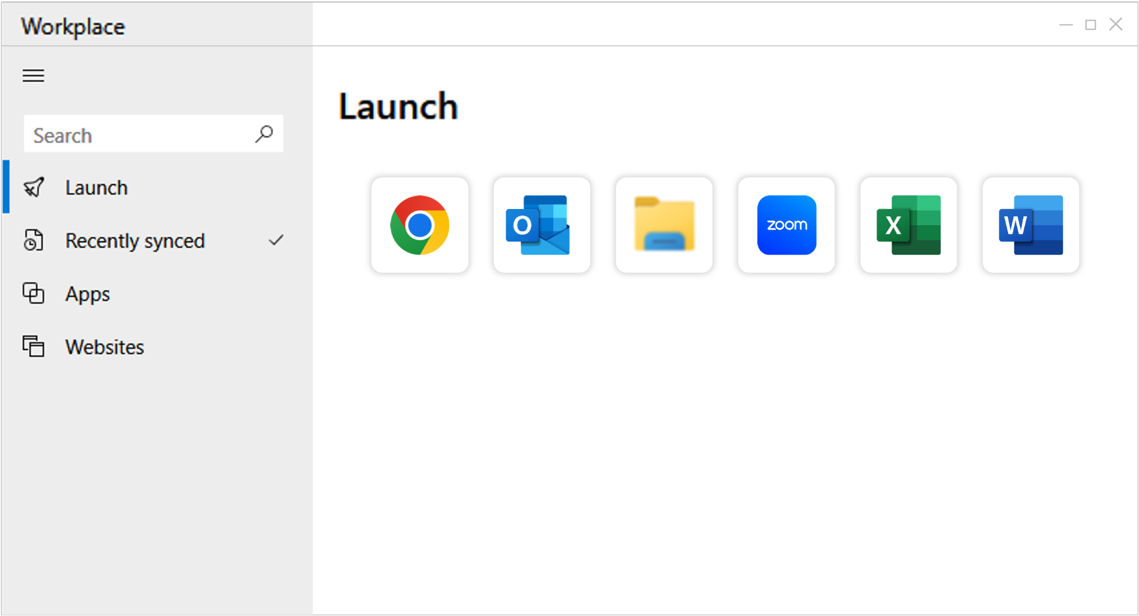
Venn’s Workplace App
Notes:
Once you install Venn, you’ll use the Venn Launcher app, called Workplace, to open any work-related apps, websites, or files instead of launching them from places like your start menu on a PC or your dock on a Mac.

Slide 7
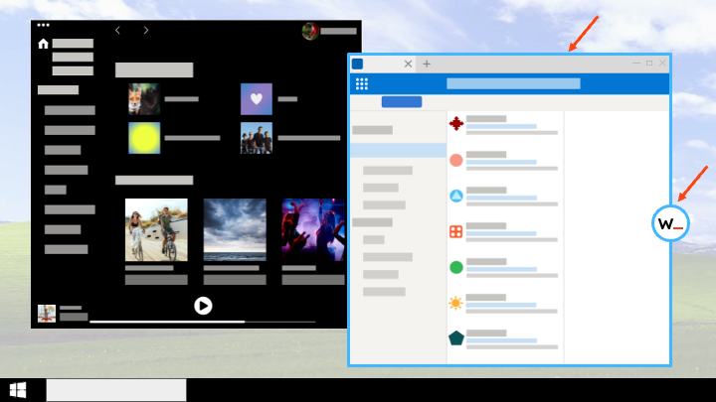
Blue Border™ & Badge
Notes:
Any of your work apps, websites, or files that you launch from Venn’s Workplace app will open with a Blue Border around them. The Blue Border acts as your visual cue letting you know you are in work mode.
Venn makes it possible for you to have the flexibility to use your computer the way you want for work and life. It keeps all of your personal computer activities and data completely separate and secure from anything work related.
You can see in this example that the person has an email app open inside the Blue Border and a music streaming app open outside of the Blue Border. We know that people need to toggle back and forth between work and personal use of their device and the Blue Border lets you do that seamlessly.
Applications that you launch outside of the Venn Launcher (for example from the Start Menu or from your Desktop on Windows; from Finder or the Launchpad in your Dock on Mac) are personal and will launch without a Blue Border. They are completely isolated from work (Blue Border) applications, almost as though they were running on separate computers.

Slide 8
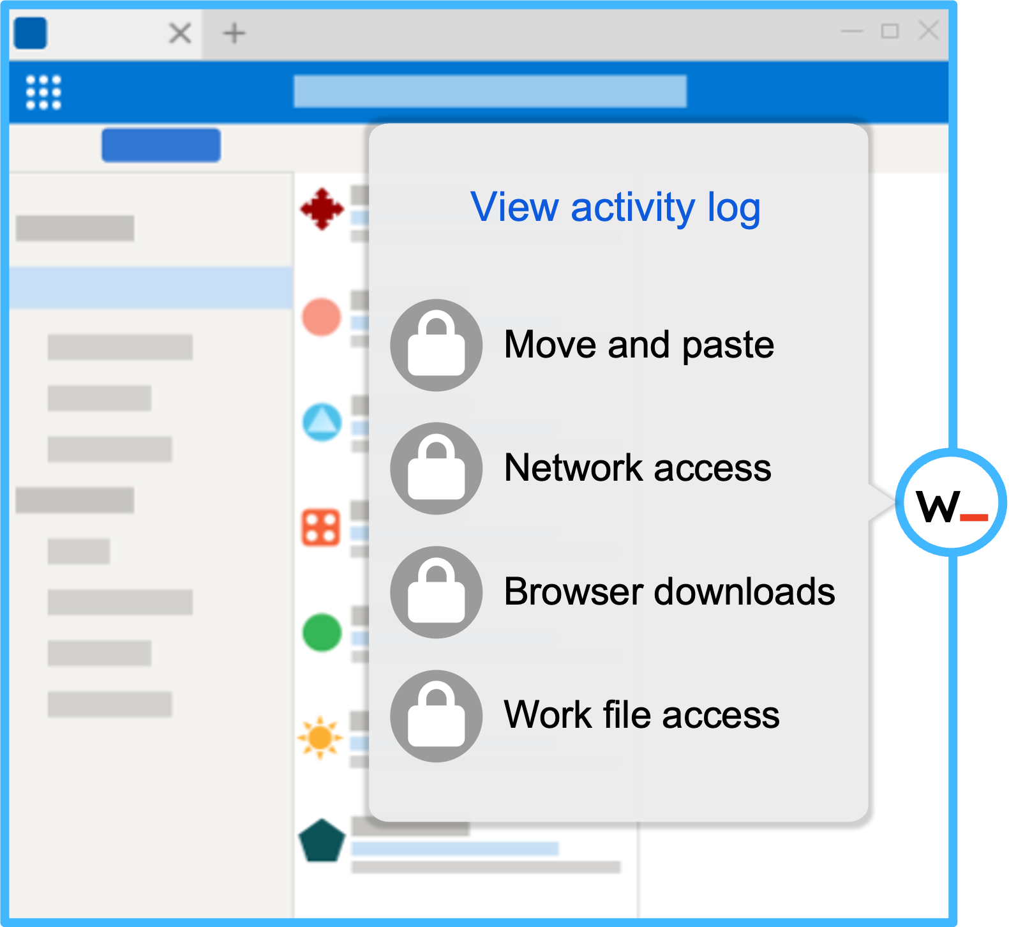
Blue Border™ & Badge
Notes:
Every application that you open from the Venn Launcher will have the Blue Border and a round Badge on the right side of the application window.
If you click on the Badge, you can access a few important things:
You’ll be able to access your activity log to see what work activity is being tracked by Venn.
You’ll see a list of our Data Loss Prevention policies that manage what you can and can’t do within the Blue Border.
And you’ll have access to help should you need it.

Slide 9
What is Venn?
Our Goal
You will be prepared to set up and begin using Venn for work on your personal computer.
Venn Onboarding
Expectations
Notes:
Now that you’ve heard how Venn’s Blue Border works, let’s talk about how you’ll get started.

Slide 10
The Onboarding Process
1
2
3
Get Your Device Ready
Install Venn’s Workplace app
Open Work Apps
Inside the Blue Border™
Notes:
There are three things you’ll need to do before you start using Venn on your personal computer.
We’ll provide detailed instructions for all of this, but I want to give you an overview of the process now.
You’ll need to ensure that your device meets the system, software, and compliance requirements that we have in place.
Once your device is ready to go, you’ll log in to Venn, download Venn’s Workplace app, and enable permissions for it to run on your device.
Then, you’ll open your work apps for the first time in the Blue Border.
You’ll need to make sure that you have your essential work apps like [list essential apps for email, chat, etc.] downloaded on your computer.
When you open them in the Blue Border for the first time, you may need to sign in and update your settings for work.

Slide 11
Available Resources
Introductory Video
Today’s Session
Installation Instructions
Notes:
We have a variety of resources available to support you as you set up Venn.
In addition to today’s session:
We have an introductory video
And comprehensive installation instructions for Mac, PC, Android, and Apple mobile devices
[explain where/how to find these resources]

Slide 12
What is Venn?
Our Goal
You will be prepared to set up and begin using Venn for work on your personal computer.
Venn Onboarding
Expectations
Notes:
And finally, let’s talk about expectations!

Slide 13
Timeline
Use Venn for All Work on Your Personal Computer
Install and Set Up Venn
STARTING [DATE]
Introduction & Education Sessions
[DATE] - [DATE]
[DATE] - [DATE]
Notes:
Here is our timeline for rolling out Venn.
[explain timeline]

Slide 14
Expectations for Use
1
[Expectation 1]
2
[Expectation 2]
3
[Expectation 3]
Notes:
We have a few key expectations that will help ensure security and protect your privacy now that we’ve partnered with Venn.
[detail expectations]

Slide 15
What questions do you have?
Please add your questions in the chat.
Notes:
I’m sure many of you have questions. Please share them in the chat.

